Slide 1

IF351 DATABASE SYSTEMS
07 SELECT STATEMENT 2 & 3
DENNIS GUNAWAN

Slide 2
REVIEW: SELECT STATEMENT 1
SELECT
FROM
WHERE
Operators
Aggregation Functions

Slide 3
COURSE SUB LEARNING OUTCOMES (SUB-CLO)
Sub-CLO 7
Students are able to use SELECT statement (C3)

Slide 4
OUTLINE
GROUP BY
HAVING
ORDER BY
LIMIT
CASE Expression
Subquery

Slide 5
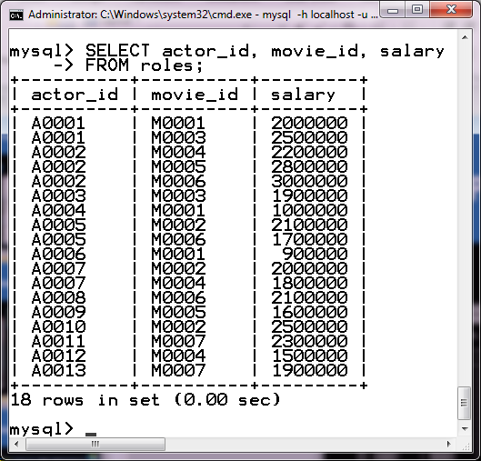
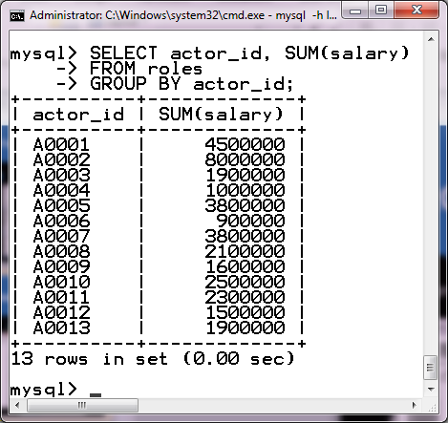
GROUP BY CLAUSE
SELECT actor_id, SUM(salary) FROM roles
GROUP BY actor_id;

Slide 6
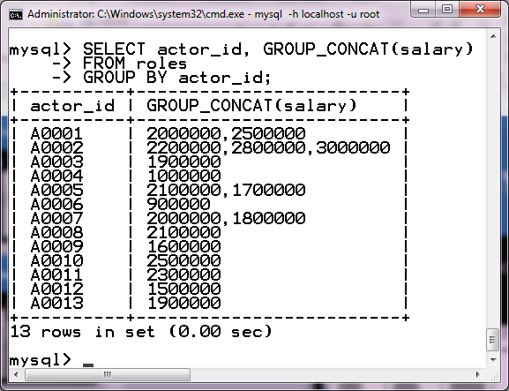
GROUP BY CLAUSE: GROUP_CONCAT FUNCTION
SELECT actor_id, GROUP_CONCAT(salary) FROM roles
GROUP BY actor_id;

Slide 7
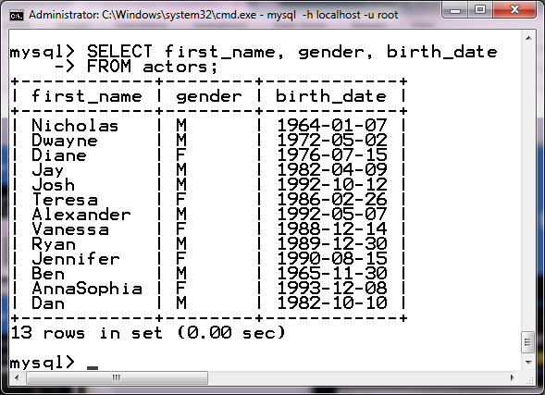
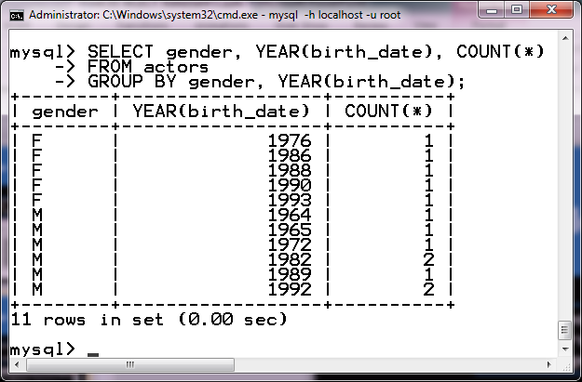
GROUP BY CLAUSE
SELECT gender, YEAR(birth_date), COUNT(*)
FROM actors
GROUP BY gender, YEAR(birth_date);

Slide 8
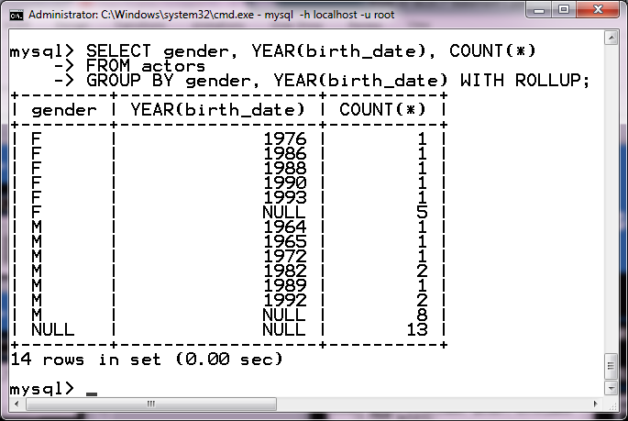
GROUP BY CLAUSE:WITH ROLLUP
SELECT gender, YEAR(birth_date), COUNT(*)
FROM actors
GROUP BY gender, YEAR(birth_date) WITH ROLLUP;

Slide 9
HAVING CLAUSE
HAVING Clause
HAVING clause is used to select rows after a GROUP BY clause has been executed
Expressions in the condition of a HAVING clause can contain aggregation functions
WHERE Clause
WHERE clause is used to select rows after the FROM clause has been processed
Expressions in the condition of a WHERE clause cannot contain aggregation functions

Slide 10
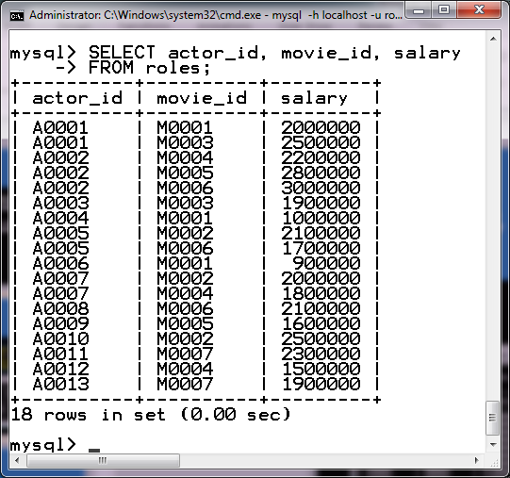
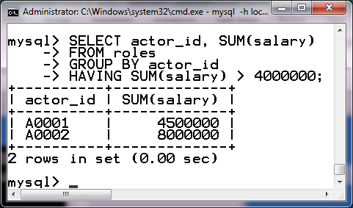
HAVING CLAUSE
SELECT actor_id, SUM(salary) FROM roles
GROUP BY actor_id
HAVING SUM(salary) > 4000000;

Slide 11
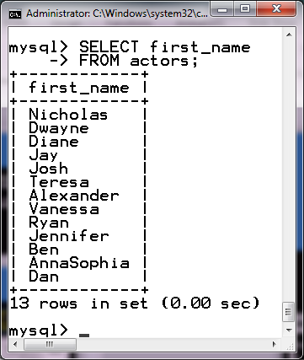
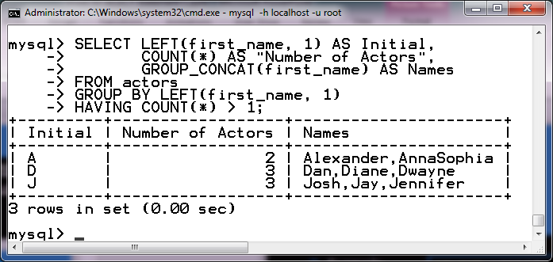
HAVING CLAUSE
SELECT LEFT(first_name, 1) AS Initial, COUNT(*) AS “Number of Actors”, GROUP_CONCAT(first_name) AS Names
FROM actors
GROUP BY LEFT(first_name, 1) HAVING COUNT(*) > 1;

Slide 12
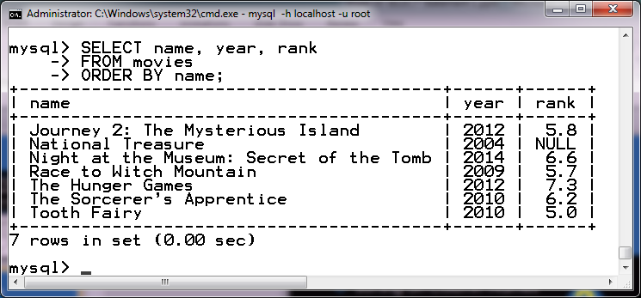
ORDER BY CLAUSE: SORTING ON COLUMN NAMES
SELECT name, year, rank FROM movies
ORDER BY name;

Slide 13
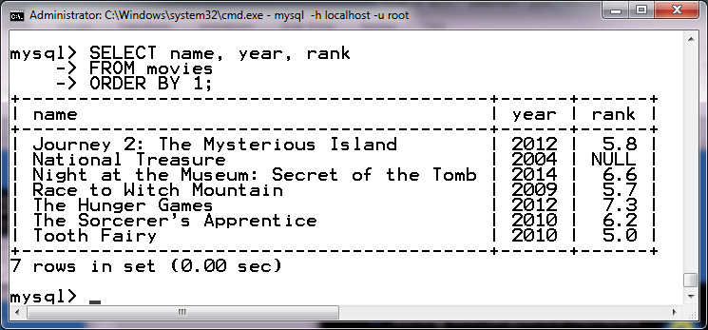
ORDER BY CLAUSE: SORTING WITH SEQUENCE NUMBERS
SELECT name, year, rank FROM movies
ORDER BY 1;

Slide 14
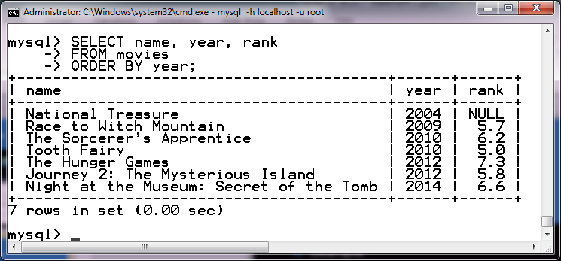
ORDER BY CLAUSE
SELECT name, year, rank FROM movies
ORDER BY year;
SELECT name, year, rank FROM movies
ORDER BY 2;

Slide 15
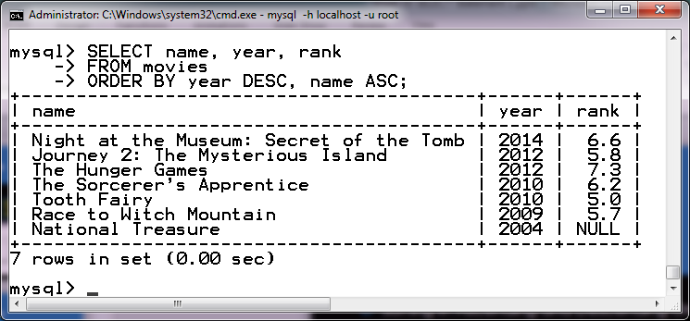
ORDER BY CLAUSE:
SORTING IN ASCENDING AND DESCENDING ORDER
SELECT name, year, rank FROM movies
ORDER BY year DESC, name ASC;

Slide 16
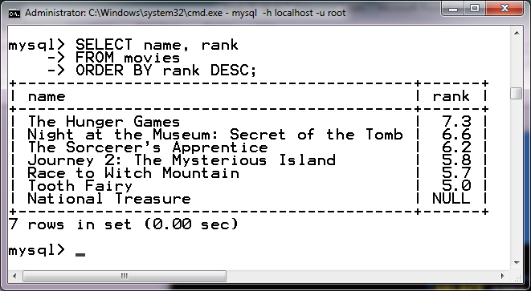
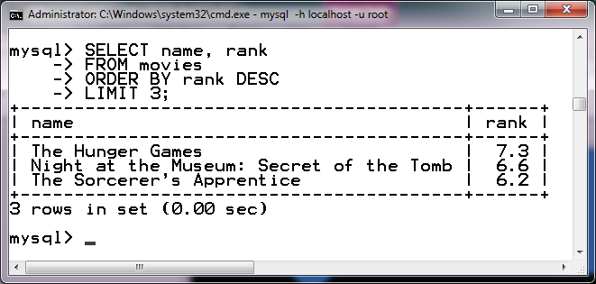
LIMIT CLAUSE
SELECT name, rank FROM movies
ORDER BY rank DESC LIMIT 3;

Slide 17
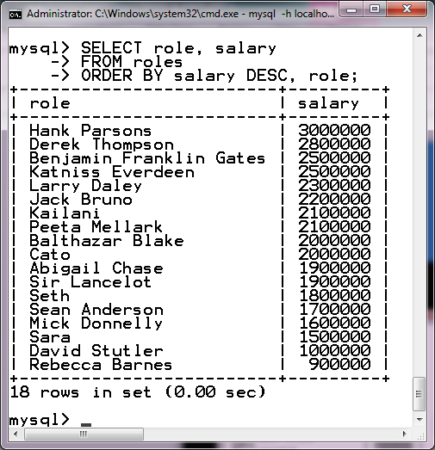
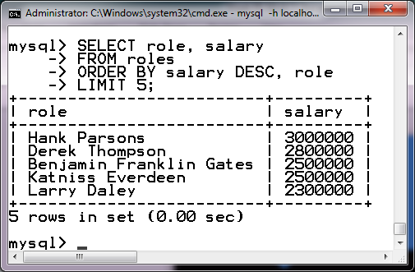
LIMIT CLAUSE
SELECT role, salary FROM roles
ORDER BY salary DESC, role LIMIT 5;

Slide 18
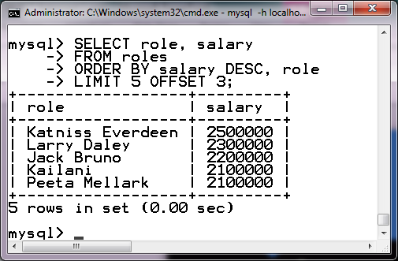
LIMIT CLAUSE: LIMIT WITH AN OFFSET
SELECT role, salary FROM roles
ORDER BY salary DESC, role LIMIT 5 OFFSET 3;

Slide 19
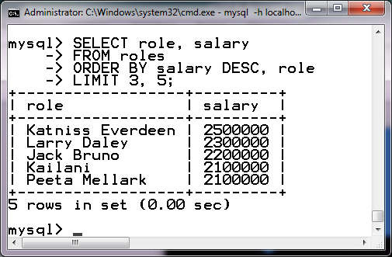
LIMIT CLAUSE: LIMIT WITH AN OFFSET
SELECT role, salary FROM roles
ORDER BY salary DESC, role LIMIT 3, 5;

Slide 20
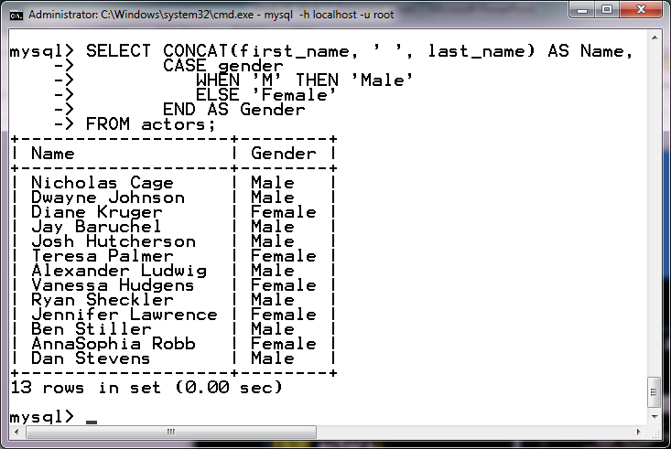
CASE EXPRESSION
SELECT CONCAT(first_name, ‘ ’, last_name) AS Name,
CASE gender
WHEN ‘M’ THEN ‘Male’
ELSE ‘Female’
END AS Gender FROM actors;

Slide 21
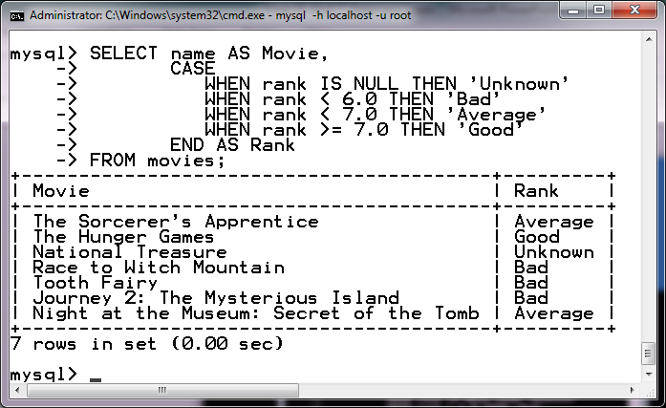
CASE EXPRESSION
SELECT name AS Movie,
CASE
WHEN rank IS NULL THEN ‘Unknown’ WHEN rank < 6.0 THEN ‘Bad’
WHEN rank < 7.0 THEN ‘Average’ WHEN rank >= 7.0 THEN ‘Good’
END AS Rank FROM movies;

Slide 22
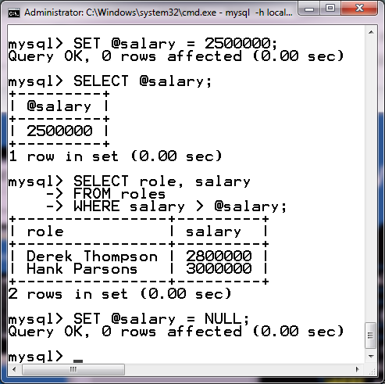
USER VARIABLE & SET STATEMENT
SET @salary = 2500000;
SELECT @salary;
SELECT role, salary
FROM roles
WHERE salary > @salary;
SET @salary = NULL;

Slide 23
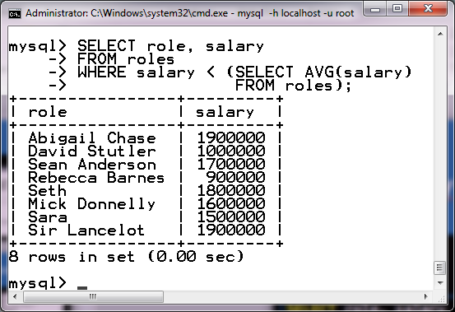
SUBQUERY
SELECT role, salary FROM roles
WHERE salary < (SELECT AVG(salary)
FROM roles);

Slide 24
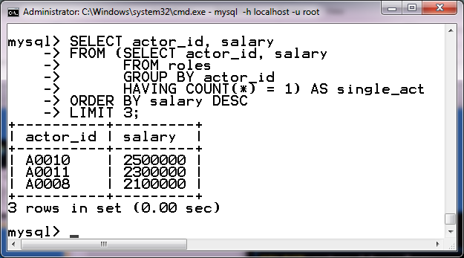
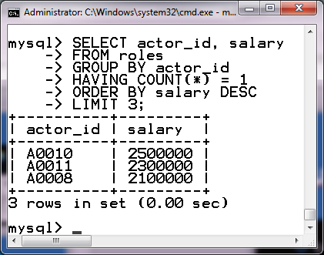
SUBQUERY
SELECT actor_id, salary
FROM (SELECT actor_id, salary FROM roles
GROUP BY actor_id
HAVING COUNT(*) = 1) AS single_act
ORDER BY salary DESC LIMIT 3;
SELECT actor_id, salary
FROM roles
GROUP BY actor_id HAVING COUNT(*) = 1
ORDER BY salary DESC LIMIT 3;

Slide 25
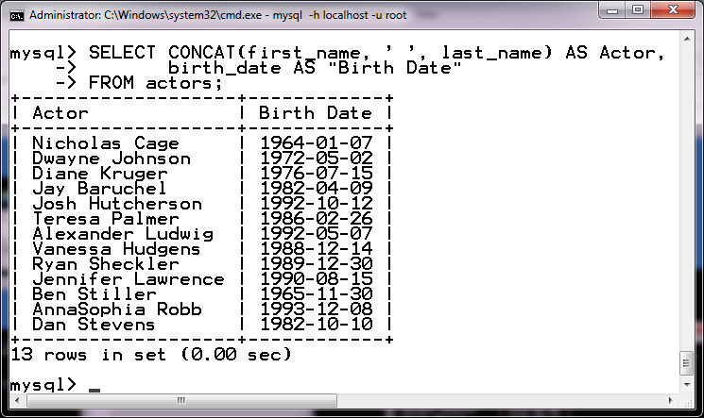
SUBQUERY: ALL & ANY OPERATORS
SELECT CONCAT(first_name, ‘ ’, last_name) AS Actor,
birth_date AS “Birth Date”
FROM actors
WHERE birth_date < ALL (SELECT birth_date FROM actors
WHERE YEAR(birth_date) % 2 <> 0);

Slide 26
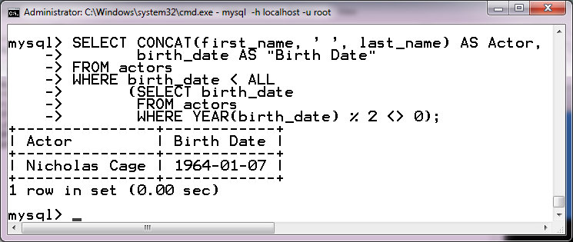
SUBQUERY: ALL & ANY OPERATORS
< ALL → < MINIMUM

Slide 27
SUBQUERY: ALL & ANY OPERATORS
SELECT CONCAT(first_name, ‘ ’, last_name) AS Actor,
birth_date AS “Birth Date”
FROM actors
WHERE birth_date > ALL (SELECT birth_date FROM actors
WHERE YEAR(birth_date) % 2 <> 0);

Slide 28
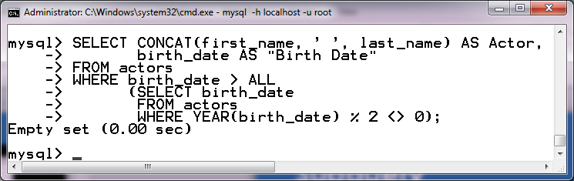
SUBQUERY: ALL & ANY OPERATORS
> ALL → > MAXIMUM

Slide 29
SUBQUERY: ALL & ANY OPERATORS
SELECT CONCAT(first_name, ‘ ’, last_name) AS Actor,
birth_date AS “Birth Date”
FROM actors
WHERE birth_date < ANY (SELECT birth_date FROM actors
WHERE YEAR(birth_date) % 2 <> 0);

Slide 30
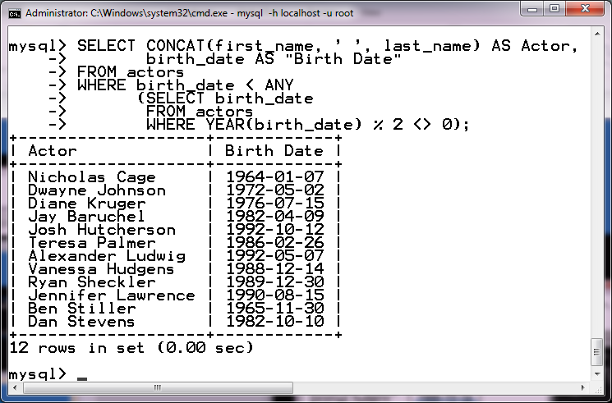
SUBQUERY: ALL & ANY OPERATORS
< ANY → < MAXIMUM

Slide 31
SUBQUERY: ALL & ANY OPERATORS
SELECT CONCAT(first_name, ‘ ’, last_name) AS Actor,
birth_date AS “Birth Date”
FROM actors
WHERE birth_date > ANY (SELECT birth_date FROM actors
WHERE YEAR(birth_date) % 2 <> 0);

Slide 32
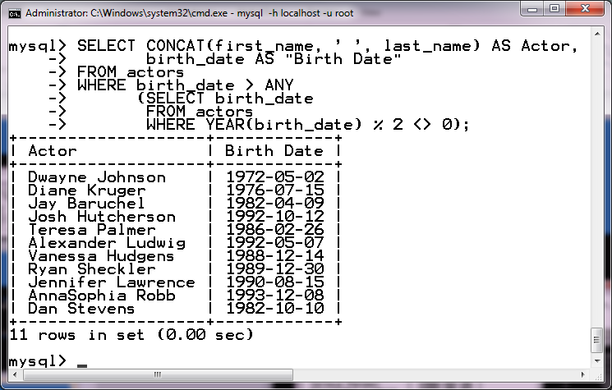
SUBQUERY: ALL & ANY OPERATORS
> ANY → > MINIMUM

Slide 33
SUBQUERY: ALL & ANY OPERATORS
SELECT CONCAT(first_name, ‘ ’, last_name) AS Actor,
birth_date AS “Birth Date”
FROM actors
WHERE birth_date = ANY (SELECT birth_date FROM actors
WHERE YEAR(birth_date) % 2 <> 0);

Slide 34
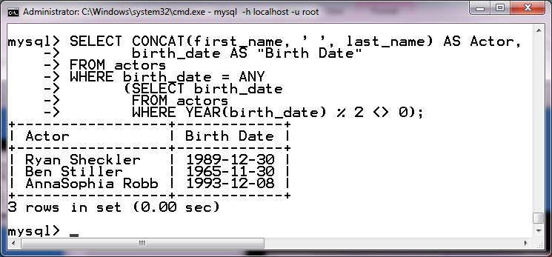
SUBQUERY: ALL & ANY OPERATORS
= ANY → ?

Slide 35
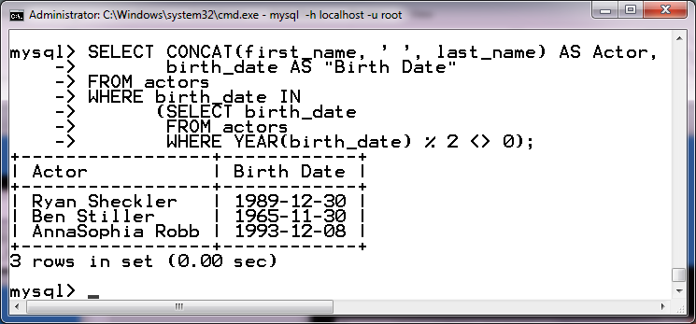
SUBQUERY: ALL & ANY OPERATORS
= ANY → IN
[LECTURE SLIDES] Week02

Slide 36
IF351 DATABASE SYSTEMS
07 SELECT STATEMENT 3
DENNIS GUNAWAN

Slide 37
OUTLINE
JOIN
Set Operator

Slide 38
MULTIPLE TABLE SPECIFICATIONS IN THE FROM CLAUSE
SELECT CONCAT(first_name, ‘ ’, last_name) AS Actor, role AS Role
FROM actors, roles WHERE id = actor_id;

Slide 39
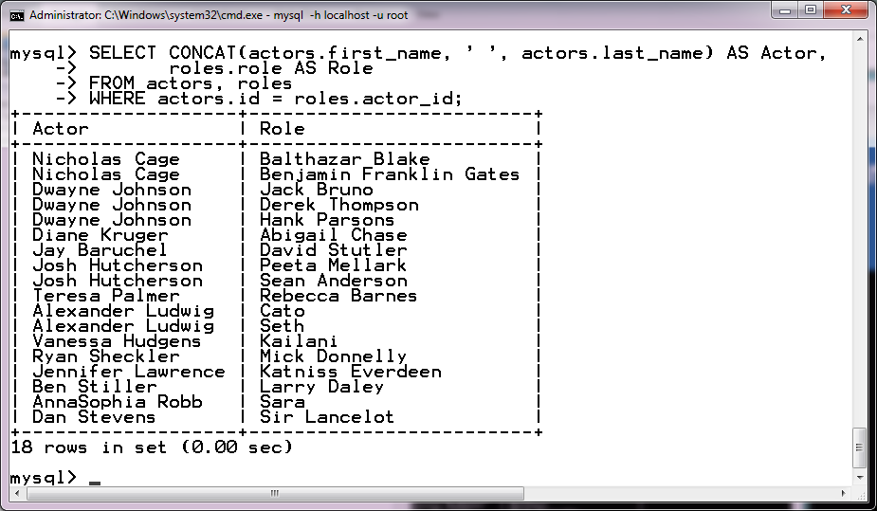
MULTIPLE TABLE SPECIFICATIONS IN THE FROM CLAUSE
SELECT CONCAT(actors.first_name, ‘ ’, actors.last_name) AS Actor,
roles.role AS Role FROM actors, roles
WHERE actors.id = roles.actor_id;

Slide 40
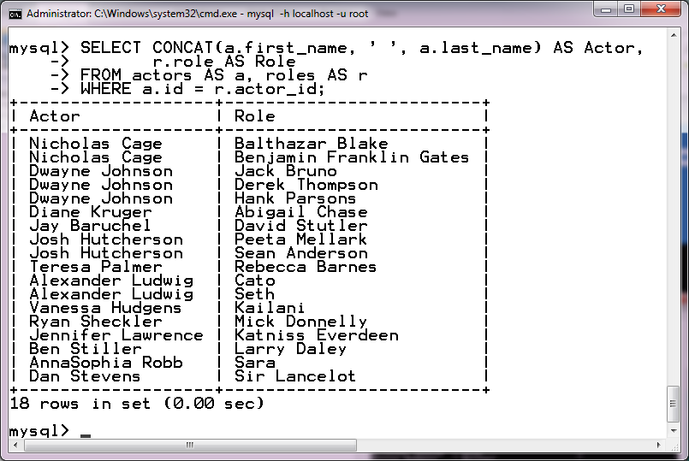
MULTIPLE TABLE SPECIFICATIONS IN THE FROM CLAUSE: PSEUDONYMS FOR TABLE NAMES
SELECT CONCAT(a.first_name, ‘ ’, a.last_name) AS Actor,
r.role AS Role
FROM actors AS a, roles AS r WHERE a.id = r.actor_id;

Slide 41
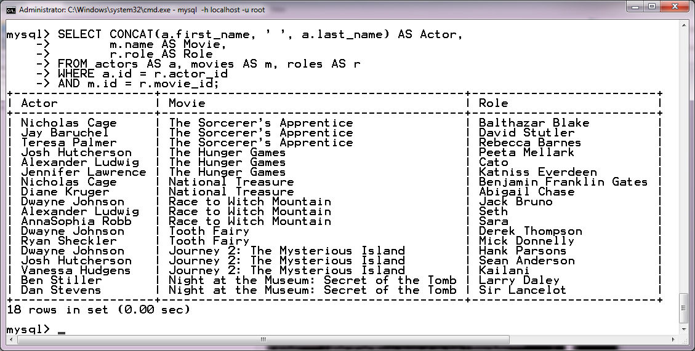
MULTIPLE TABLE SPECIFICATIONS IN THE FROM CLAUSE
SELECT CONCAT(a.first_name, ‘ ’, a.last_name) AS Actor,
m.name AS Movie, r.role AS Role
FROM actors AS a, movies AS m, roles AS r
WHERE a.id = r.actor_id AND m.id = r.movie_id;

Slide 42
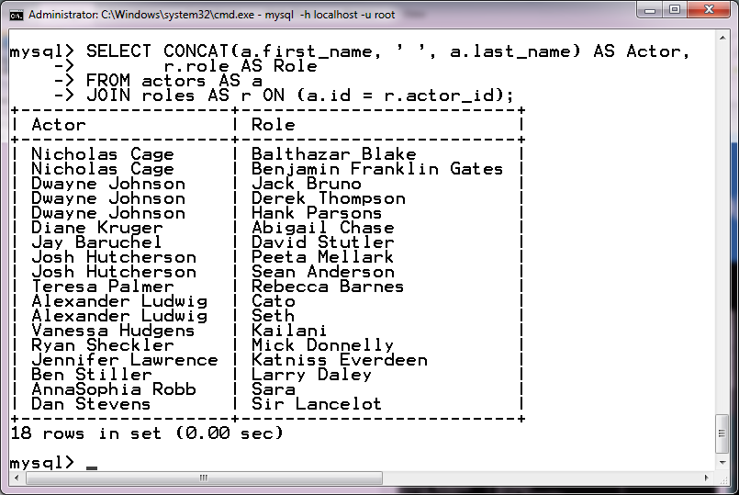
EXPLICIT JOINS IN THE FROM CLAUSE
SELECT CONCAT(a.first_name, ‘ ’, a.last_name) AS Actor,
r.role AS Role FROM actors AS a
JOIN roles AS r ON (a.id = r.actor_id);

Slide 43
EXPLICIT JOINS IN THE FROM CLAUSE
SELECT CONCAT(a.first_name, ‘ ’, a.last_name) AS Actor, r.role AS Role
FROM actors AS a
INNER JOIN roles AS r ON (a.id = r.actor_id);

Slide 44
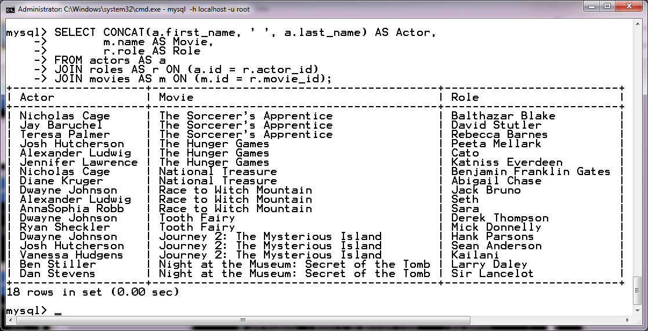
EXPLICIT JOINS IN THE FROM CLAUSE
SELECT CONCAT(a.first_name, ‘ ’, a.last_name) AS Actor,
m.name AS Movie, r.role AS Role
FROM actors AS a JOIN roles AS r
ON (a.id = r.actor_id) JOIN movies AS m
ON (m.id = r.movie_id);

Slide 45
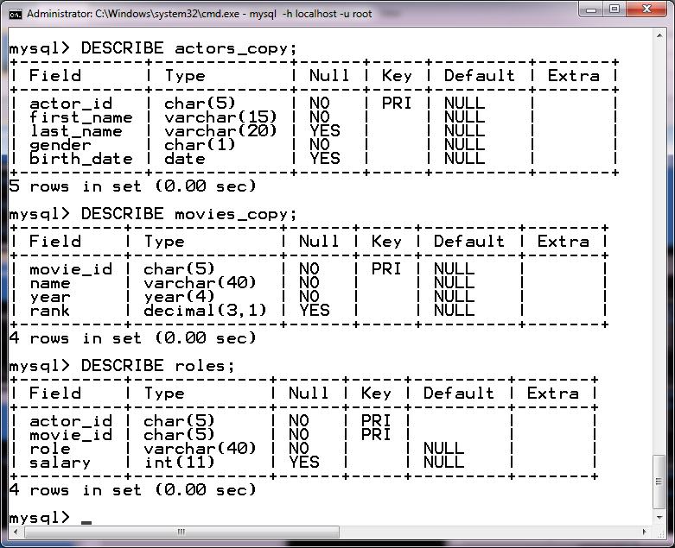
REPLACING JOIN CONDITIONS WITH USING
SELECT CONCAT(a.first_name, ‘ ’, a.last_name) AS Actor,
 | m.name AS | Movie,
 | r.role AS | Role
FROM | actors_copy | AS a
JOIN roles AS r USING (actor_id)
JOIN movies_copy AS m USING (movie_id);

Slide 46
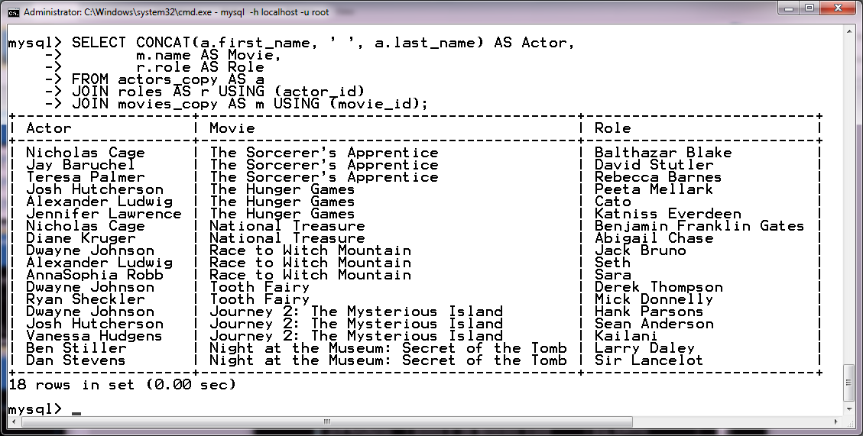
REPLACING JOIN CONDITIONS WITH USING

Slide 47
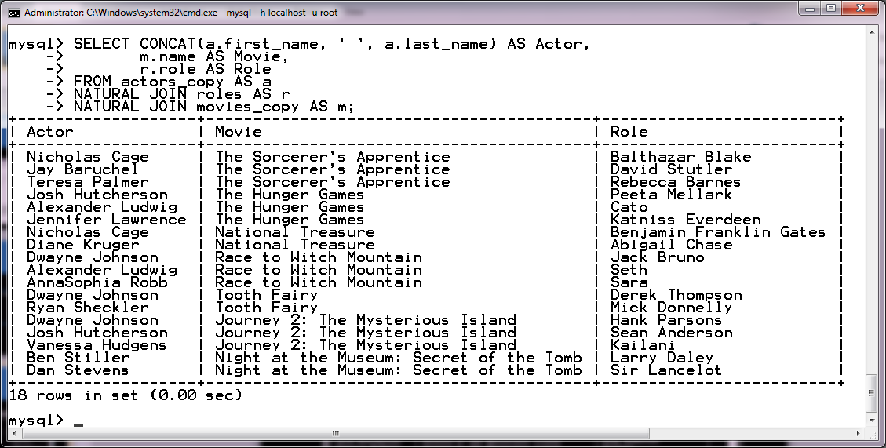
NATURAL JOIN
SELECT CONCAT(a.first_name, ‘ ’, a.last_name) AS Actor,
m.name AS Movie, r.role AS Role
FROM actors_copy AS a NATURAL JOIN roles AS r
NATURAL JOIN movies_copy AS m;

Slide 48
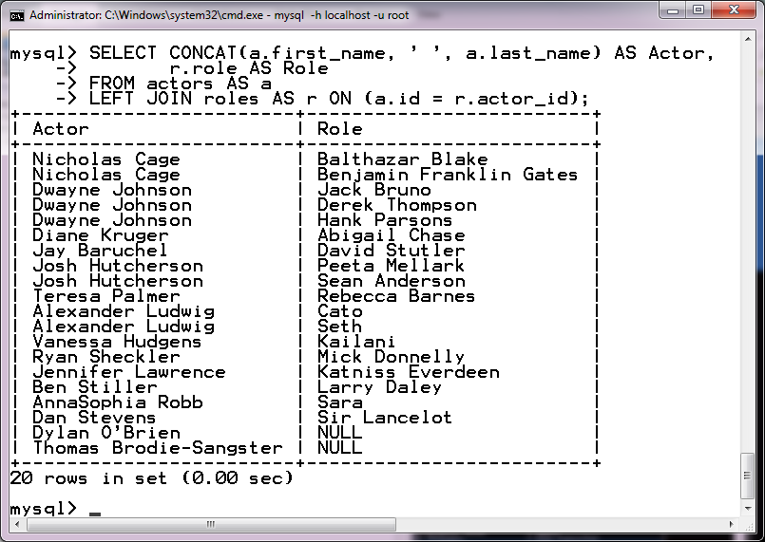
OUTER JOINS: LEFT OUTER JOIN
SELECT CONCAT(a.first_name, ‘ ’, a.last_name) AS Actor,
r.role AS Role FROM actors AS a LEFT JOIN roles AS r
ON (a.id = r.actor_id);

Slide 49
OUTER JOINS: LEFT OUTER JOIN
SELECT CONCAT(a.first_name, ‘ ’, a.last_name) AS Actor, r.role AS Role
FROM actors AS a
LEFT OUTER JOIN roles AS r ON (a.id = r.actor_id);

Slide 50
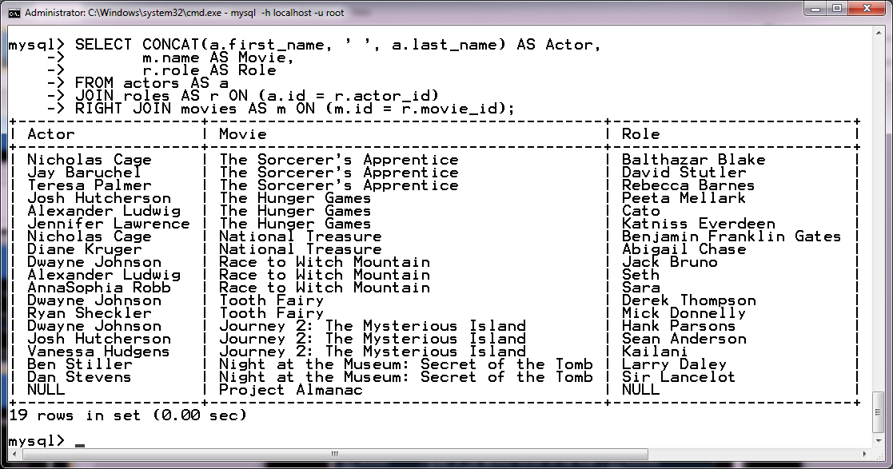
OUTER JOINS: RIGHT OUTER JOIN
SELECT CONCAT(a.first_name, ‘ ’, a.last_name) AS Actor,
m.name AS Movie, r.role AS Role
FROM actors AS a JOIN roles AS r
ON (a.id = r.actor_id) RIGHT JOIN movies AS m ON (m.id = r.movie_id);

Slide 51
OUTER JOINS: RIGHT OUTER JOIN
SELECT CONCAT(a.first_name, ‘ ’, a.last_name) AS Actor, m.name AS Movie,
r.role AS Role FROM actors AS a
JOIN roles AS r ON (a.id = r.actor_id)
RIGHT OUTER JOIN movies AS m ON (m.id = r.movie_id);

Slide 52
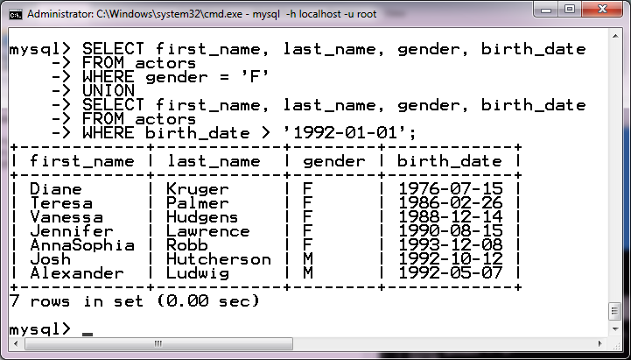
SET OPERATOR: UNION
SELECT first_name, last_name, gender, birth_date
FROM actors
WHERE gender = ‘F’
UNION
SELECT first_name, last_name,
gender, birth_date FROM actors
WHERE birth_date > ‘1992-01-01’;

Slide 53
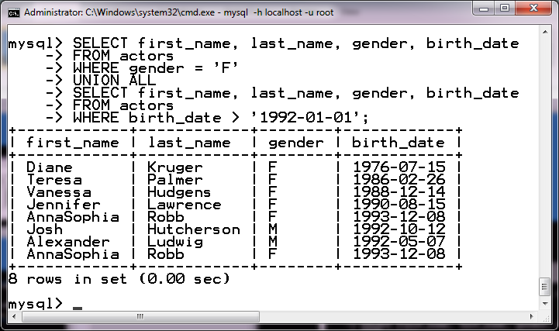
SET OPERATOR: UNION ALL
SELECT first_name, last_name, gender, birth_date
FROM actors
WHERE gender = ‘F’
UNION ALL
SELECT first_name, last_name,
gender, birth_date FROM actors
WHERE birth_date > ‘1992-01-01’;

Slide 54
REFERENCES
Elmasri, Ramez and Shamkant B. Navathe (2016), Fundamentals of Database Systems, 7th edition, Addison Wesley.
Rick F. van der Lans (2007), SQL for MySQL Developers, Addison Wesley.
Connolly,Thomas and Carolyn Begg (2015), Database Systems A Practical Approach to Design, Implementation, and Management, 6th edition, Pearson Education, ISBN 13: 978-1-292-06118-4, Essex, England.

Slide 55
SELECT * FROM WORLD
WHERE SOMEONE LIKE ‘%YOU%’;
EMPTY SET (0.00 SEC)

Slide 56

Vision
To become an outstanding undergraduate Computer Science program that produces international-minded graduates who are competent in software engineering and have entrepreneurial spirit and noble character.
I N F O R M A T I K A
Mission
To conduct studies with the best technology and curriculum, supported by professional lecturer
To conduct research in Informatics to promote science and technology
To deliver science-and-technology-based society services to implement science and technology

